Slide 1
Files and Data
Notes:
HTML5 introduces a File API that allows you to read files on the local file system.
There's also a drag-and-drop API that allows you to drag-and-drop files onto elements in your Web page, or to drag-and-drop elements onto each other.
On top of all this, there's a Web database API called IndexedDB that allows you to use No-SQL techniques to store data at the client.

Slide 2
Contents
File handling
Drag-and-drop
IndexedDB databases
Annex
Web SQL databases
Demos folder:
Demos\13-FilesData
Notes:
Section 1 introduces the File API. We'll show how to read binary data and text data using this API.
Section 2 describes the drag-and-drop support. As an example, we'll show how to drag files onto some elements on a Web page.
Section 3 shows how to use the IndexedDB API in a Web page, to save/restore/lookup data stored in the local file system.
The annex at the end of the chapter discusses an older database technology called Web SQL. This is officially deprecated now, but we've included a discussion here in case you encounter it on any existing Web applications.

Slide 3
1. File Handling
Overview of the HTML5 file API
Reading file content
Example
Notes:
The File API allows you to locate files and read their content in a Web page. You can read binary data or text data into your application.

Slide 4
Overview of the HTML5 File API
HTML5 has a standardized File API
Allows an HTML page to interact with local files
The File API defines several interfaces for representing file objects in a Web application:
File
Blob
FileList
Notes:
The File API defines several interfaces for representing file objects in Web applications:
Blob Represents an immutable slice of raw data. This is handy for incrementally uploading a file to a server. The Blob interface has size and type read-only properties.
File Represents an individual file. Inherits from the Blob interface and has name and lastModifiedDate read-only properties.
FileList An array-like sequence of File objects, obtained via drag-and-drop or by the user selection files in an <input type="file"> control.
For full information about the File API, see:
http://www.w3.org/TR/FileAPI/

Slide 5
Reading File Content
HTML5 has a FileReader object, to read file content
Reads a text or binary file into memory (asynchronously)
You should handle the load and error events
You can also handle the progress and abort events
FileReader methods for reading a file:
void readAsText(fileOrBlob, optionalEncoding)
void readAsArrayBuffer(fileOrBlob)
void readAsBinaryString(fileOrBlob)
void readAsDataURL(fileOrBlob)
Notes:
To read data from a file, you must use a FileReader object (note there's no equivalent FileWriter object, for reasons of security).
The FileReader object has various methods for reading data from a file, as listed on the slide. Each of these methods is asynchronous. You must handle load and error events, which are invoked when the data has been loaded or if an error has occurred.
The event-handler function receives an event object, through which you can access a result property. The value of this property depends on which method you used to do the read operation:
readAsText() result property contains the contents of the file, as a text string.
readAsArrayBuffer() result property contains the contents of the file, as an ArrayBuffer.
readAsBinaryString() [deprecated] result property contains the contents of the file, as raw binary data.
readAsDataURL() result property contains a data: URL representing the file's data.

Slide 6
Example (1 of 2)
Example
See FileHandling/DemoFileHandling.html
<input type="file" id="theTextFile" onchange="onLoadTextFile()" />
<textArea id="theMessageArea" rows="30" cols="40"></textArea>
function onLoadTextFile() {
var theFileElem = document.getElementById("theTextFile");
// Get the File object selected by the user (and make sure it's a text file).
if (theFileElem.files.length != 0 && theFileElem.files[0].type.match(/text.*/)) {
// Create a FileReader and handle the onload and onerror events.
var reader = new FileReader();
reader.onload = function(e){
var theMessageAreaElem = document.getElementById("theMessageArea");
theMessageAreaElem.value = e.target.result;
};
reader.onerror = function(e){
alert("Cannot load text file");
};
// Read text file (the 2nd parameter is optional - the default encoding is "UTF-8").
reader.readAsText(theFileElem.files[0], "ISO-8859-1");
} else {
alert("Please select a text file");
}
}
Notes:
This example shows how to load a text file from the file system, and display its contents in a <textArea> element on the Web page.
Run the example and click the Choose File button on the left-hand side of the Web page, to load a text file. Select a file such as AnthemFrance.txt. The Web page loads the file and displays its contents as follows:

Slide 7
Example (2 of 2)
Example (continued)
See FileHandling/DemoFileHandling.html
<input type="file" id="theBinaryFile" onchange="onLoadBinaryFile()" />
<img id="theImg"></img>
function onLoadBinaryFile() {
var theFileElem = document.getElementById("theBinaryFile");
// Get the File object selected by the user (and make sure it's an image file).
if (theFileElem.files.length != 0 && theFileElem.files[0].type.match(/image.*/)) {
// Create a FileReader and handle the onload and onerror events.
var reader = new FileReader();
reader.onload = function(e){
var theImgElem = document.getElementById("theImg");
theImgElem.src = e.target.result;
};
reader.onerror = function(e){
alert("Cannot load binary file");
};
// Read the binary file.
reader.readAsDataURL(theFileElem.files[0]);
} else {
alert("Please select a binary file");
}
}
Notes:
This example shows how to load a binary file (e.g. an image) from the file system, and display its contents in an <img> element on the Web page.
Run the example and click the Choose File button on the right-hand side of the Web page, to load a binary file. Select a file such as Hahnenkamm.jpg. The Web page loads the file and displays its image contents as follows:

Slide 8
2. Drag-and-Drop
Overview of Drag-and-Drop
Enabling drag support on an HTML element
Enabling drop support on an HTML element
Example
Notes:
HTML5 allows you to drag-and-drop files from the file system onto target elements on a Web page. You can also drag one element onto another.
We'll describe how all this works in this section.

Slide 9
Overview of Drag-and-Drop
HTML5 supports drag-and-drop
You can drag elements on a web page or files in the file system…
… and drop them onto a drop-enabled element in the web page
Key steps:
Enable drag support on HTML source element (optional)
Enable drop support on HTML drop target elements
Handle drag-and-drop events on the HTML drop target elements
Notes:
If you want to be able to drag an element onto another element, the first step is to enable drag support on the source element.
You must also enable drop support on the target element. This allows you to drop files and/or other elements onto the target element.
A drag-and-drop action causes various events to occur, which you handle on the source element or the target element as appropriate.

Slide 10
Enabling Drag Support on an HTML Element
To enable a user to drag an HTML element:
Set the element's draggable attribute to true
Handle the dragstart event
The dragstart event handler has a dataTransfer property, which is a DataTransfer object
Configure the DataTransfer object via the following methods and properties:
setData(mimeType, data)
setDragImage(imgElement, x, y)
effectAllowed
dropEffect
Notes:
This slide describes how to enable drag support on the source element. This will allow you to start dragging the element onto another element on the Web page.
When you start a drag-and-drop operation, a dragstart event occurs on the source element. You must handle this event. The event-handler function receives an event object that has a dataTransfer property. This property is a DataTransfer object, which has the following properties and methods:
setData(mimeType, data) Specifies the MIME type of the data being transferred, plus the data itself.
setDragImage(imgElement, x, y) Sets a custom mouse cursor image during the drag-and-drop operation.
effectAllowed Specifies the types of drag-and-drop operations allowed, e.g. copy, move, or link.
dropEffect Specifies UI feedback when the mouse hovers over a target element. Allowed values are none, copy, move, and link.

Slide 11
Enabling Drop Support on an HTML Element
To enable a user to drop onto an HTML element:
Handle the dragover event
Handle the drop event
Implement the dragover event handler as follows:
Call preventDefault() on the event argument, to prevent default drag-over behavior
Implement the drop event handler as follows:
Call dataTransfer.getData() on the event argument, to get the data being dropped
Notes:
This slide describes how to enable drop support onto a target element. This will allow you to drop files and/or other elements onto the target element.
The dragover event occurs when a file or element is dragged over the target element. You should call preventDefault() on the event argument, to prevent the default drag-over behaviour.
The drop event occurs when a file or element is dropped on the target element. You should call dataTransfer.getData() on the event argument, to get the data being dopped.

Slide 12
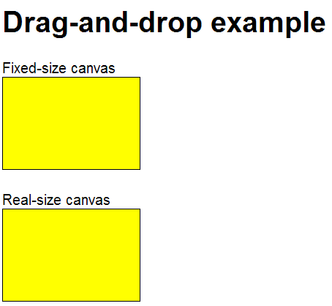

Example
Example of drag-and-drop
See DragAndDrop/DragDropFile.html
Before files dropped
After files dropped
Notes:
This example shows how to drag image files from the file system onto elements in a Web page. The Web page contains two <canvas> elements that are configured as drop targets:
If you drag an image onto the upper <canvas>, the image is resized to fit into the canvas.
If you drag an image onto the lower <canvas>, the canvas is resized to the exact size of the image.
By the way, the screenshots on the slide show the Hahnenkamm ski course in Kitzbühel ☺.

Slide 13
3. IndexedDB Databases
Overview
Essential concepts
Getting started using IndexedDB
Opening a database
Creating an object store
Putting an item into an object store
Getting all items in an object store
Deleting an item from an object store
Example
Notes:
HTML5 provides a database API! The database API is called IndexedDB and makes use of Web Storage under the covers. This allows you to create sophisticated industrial-strength client Web pages.

Slide 14
Overview
IndexedDB is a standardised HTML5 database API
An object store, i.e. a NoSQL database
Uses Web storage under the covers
An object store holds JavaScript objects
When you create an object store, you designate a particular object property as the "key" property
You can then insert whole JavaScript objects into an object store
You can retrieve an object via its key property
For full details, see:
http://www.w3.org/TR/IndexedDB/
Notes:
IndexedDB is an object store. It maintains an indexed collection of JavaScript objects. To retrieve an object from the object store, you just uses its key. There's no SQL involved.

Slide 15
Essential Concepts
IndexedDB has an asynchronous API
Non-blocking operations
You implement call-back functions to get results of operations
IndexedDB is transactional
You can only execute commands and open cursors in a transaction
Several types of transaction available, e.g. read/write, read-only, and snapshot.
We'll use read/write transactions in our example
We'll go through a worked example in the following slides
See Databases/IndexedDB.html
Notes:
Underneath the surface, IndexedDB accesses the local file system. Given this is a relatively slow task, all the operations in IndexedDB are asynchronous. Furthermore, all the operations must be enclosed in a transaction, to preserve the integrity of the data store.

Slide 16
Getting Started using IndexedDB
It's recommended to define a namespace (i.e. a JavaScript object) to encapsulate the database logic
Define a property to represent the IndexedDB instance
var myDataStore = {};
myDataStore.indexedDB = {};
Notes:
The first code block in the slide defines a JavaScript object. We'll use this as a container for our properties and methods we're going to define to encapsulate our IndexedDB operations. In this sense, the object behaves like a namespace.
The second code block defines a variable named indexedDB, which we assign an empty object initially. This object will represent out IndexedDB instance.

Slide 17
Opening a Database
To open a database:
Call open() on the standard window.indexedDB object
Specify a name and version for the database
Define an onsuccess call-back
Use e.target.result to get a handle to the open database
Also define an onerror call-back
Handle any errors that might occur
var version = 1;
var request = window.indexedDB.open('productsDB', version);
request.onsuccess = function(e) {
myDataStore.indexedDB.db = e.target.result;
// Do some additional work here, to get initial data from database.
};
request.onerror = myDataStore.indexedDB.onerror;
Notes:
The next step is to open the database, as shown in the slide. We also define handlers for the success and error events, which will be invoked when the database has been opened successfully or when an error occurs.
In the success event-handler function, the result property represents the open database. We assign this to a property named db on our indexedDB object.

Slide 18
Creating an Object Store
The next step is to create an object store (analogous to creating a table in a SQL database)
You must do this inside a versionchange transaction, which you can trigger via an onupgradeneeded call-back
To create an object store:
Specify a name for the object store
Specify which object property is the "key" property
request.onupgradeneeded = function(e) {
e.target.transaction.onerror = myDataStore.indexedDB.onerror;
var db = e.target.result;
// Delete 'product' object store if already exists.
if (db.objectStoreNames.contains('product'))
db.deleteObjectStore('product');
// Create 'product' object store, and specify 'id' property as the key property.
db.createObjectStore('product', {keyPath: 'id'});
};
Notes:
This slide shows how to create the actual object store (it's analogous to CREATE DATABASE in a SQL database). It's a bit bizarre - not very intuitive at all, but always the same kind of code, so you'll quickly get used to it.

Slide 19
Putting an Item into an Object Store
To put an item into an object store:
Start a transaction on an object store
Within the transaction, get a reference to the object store
Call put() on the object store, to put in a JavaScript object
// Assume the id, name, and price variables hold details for a new product.
var db = myDataStore.indexedDB.db;
var trans = db.transaction(['product'], 'readwrite');
var store = trans.objectStore('product');
var request = store.put({
id: id,
name: name,
price: price
});
request.onsuccess = function(e) { … };
request.onerror = function(e) { … };
Notes:
To insert an item in the object store, call the put() method and pass in your object. Note that the object store knows id is the "key" property in this example, due to the code on the previous slide.

Slide 20
Getting all Items in an Object Store
To get all items in an object store:
Start a transaction and get a reference to object store (as before)
Specify the range of keys you want to get back
Call openCursor() on the object store, to create a cursor
Implement onsuccess call-back on cursor, to process each item
var db = myDataStore.indexedDB.db;
var trans = db.transaction(['product'], 'readwrite');
var store = trans.objectStore('product');
var keyRange = IDBKeyRange.lowerBound(0);
var cursorRequest = store.openCursor(keyRange);
cursorRequest.onsuccess = function(e) {
var result = e.target.result;
if (!!result == false)
return;
// Process result.value, which is the next object in the object store.
result.continue();
};
Notes:
To get items from the object store, call the openCursor() method and pass in a key range. The onsuccess call-back will be called with each item.

Slide 21
Deleting an Item from an Object Store
To delete an item from an object store:
Start a transaction and get a reference to object store (as before)
Call delete() on the object store, to delete the item with the specified key
// Assume the id variable holds the key of the item to delete.
var db = myDataStore.indexedDB.db;
var trans = db.transaction(['product'], 'readwrite');
var store = trans.objectStore('product');
var request = store.delete(id);
request.onsuccess = function(e) { … };
request.onerror = function(e) { … };
Notes:
To delete an item from the object store, call the delete() method and pass in a particular key.

Slide 22
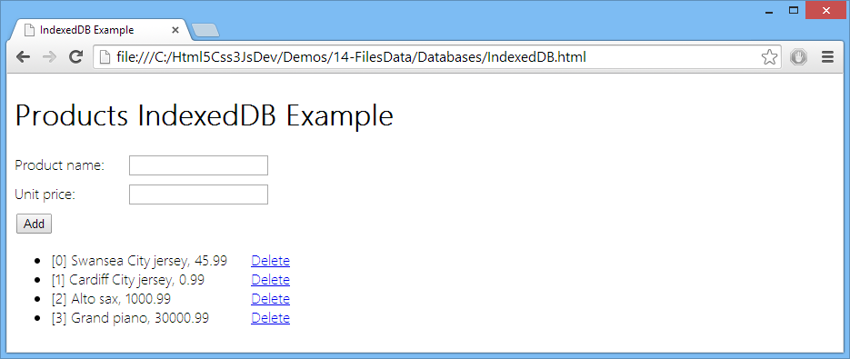
Example
Example of IndexedDB databases
See Databases/IndexedDB.html
Notes:
This demo shows a complete example of all the IndexedDB APIs and techniques we've covered in this section.

Slide 23
Summary
File handling
Drag-and-drop
IndexedDB databases
Optional lab idea:
Implement a browser database app
Store data in an IndexedDB database
Allow user to query the data
Allow user to choose files to parse
Allow user to DnD additional files

Slide 24
Annex: Web SQL Databases
Overview
Opening a database
Executing a SQL statement
Example

Slide 25
Overview
Web SQL is an early HTML5 API for storing relational data using SQL semantics
Allows you to store data in a local database
You can create/drop tables, and query/insert/update/delete data
Uses Web storage under the covers
Note:
The Web SQL API is officially deprecated by the W3C
But most major browsers still support it

Slide 26
Opening a Database
To open a database:
Call window.openDatabase()
Specify the following parameters:
Name of database
Version number
Text description
Estimated size of database
Example:
if (window.openDatabase) {
var db = window.openDatabase("myDB",
"1.0",
"My database containing info about whatever",
1024*1000);
…

Slide 27
Executing SQL Statements
To execute statements:
Call transaction() on your database object
Pass in a function to execute the statement asynchronously
The function receives a transaction object
Call its executeSql() method to execute a SQL statement in the transaction
Example:
db.transaction(function(tx) {
tx.executeSql("CREATE TABLE IF NOT EXISTS " +
"Courses(id INTEGER PRIMARY KEY, name TEXT, duration INTEGER)", []);
});

Slide 28
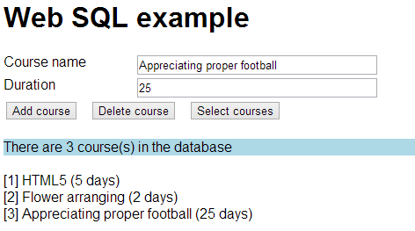
Example
Example of Web SQL databases
See Databases/WebSQL.html

Slide 29
Any Questions?

